Slide 1



AI Enabled SEWA Program
AI For Better India
Addressing Mental Illness Through AI
AMITA
PRESENTED BY : ANSHUL RAJ
SANSKAR SINGH
SHIVLI RAINA

Slide 2
We know that Mental Illness is one of the most common things a Teenager is going through. and in this state of mind one may not be interested in talking to their closest ones and upon asking to our friends and reading reports related to this situation we decided to work on this topic and try to help our nation

Slide 3
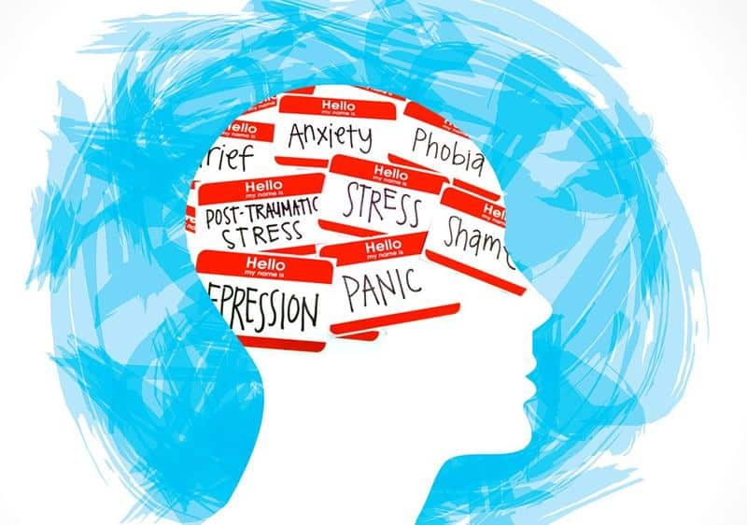
PROBLEM
To help people, especially the youth, for avoiding triggers to depression and anxiety preventing relapse and provide suggestions to the ones who are already affected by the same.

Slide 4
SOLUTION DESIGN

Slide 5
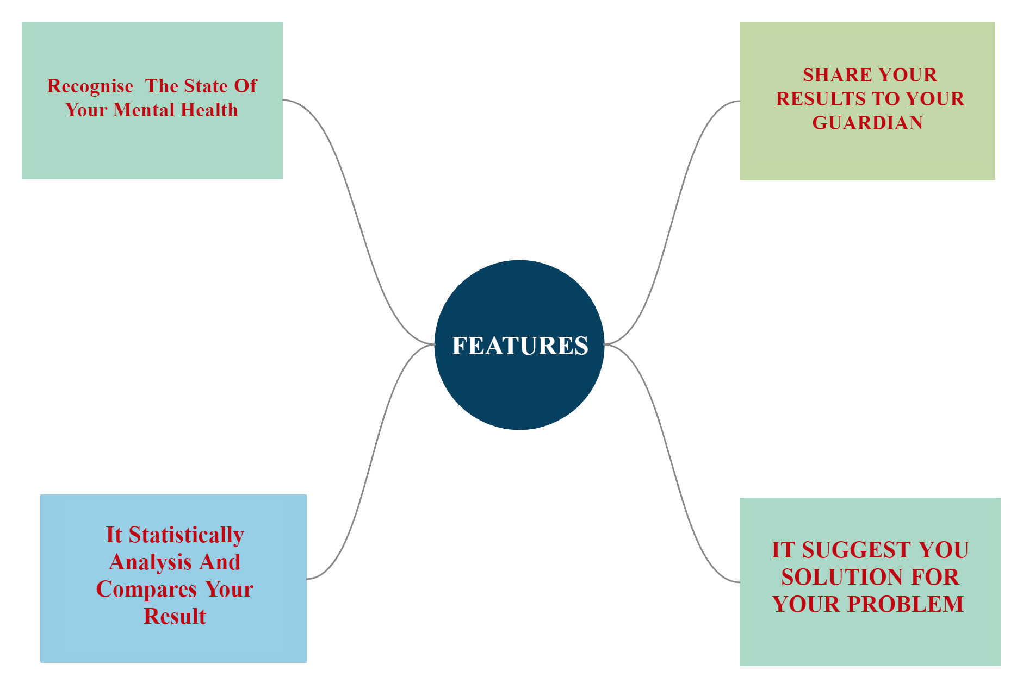
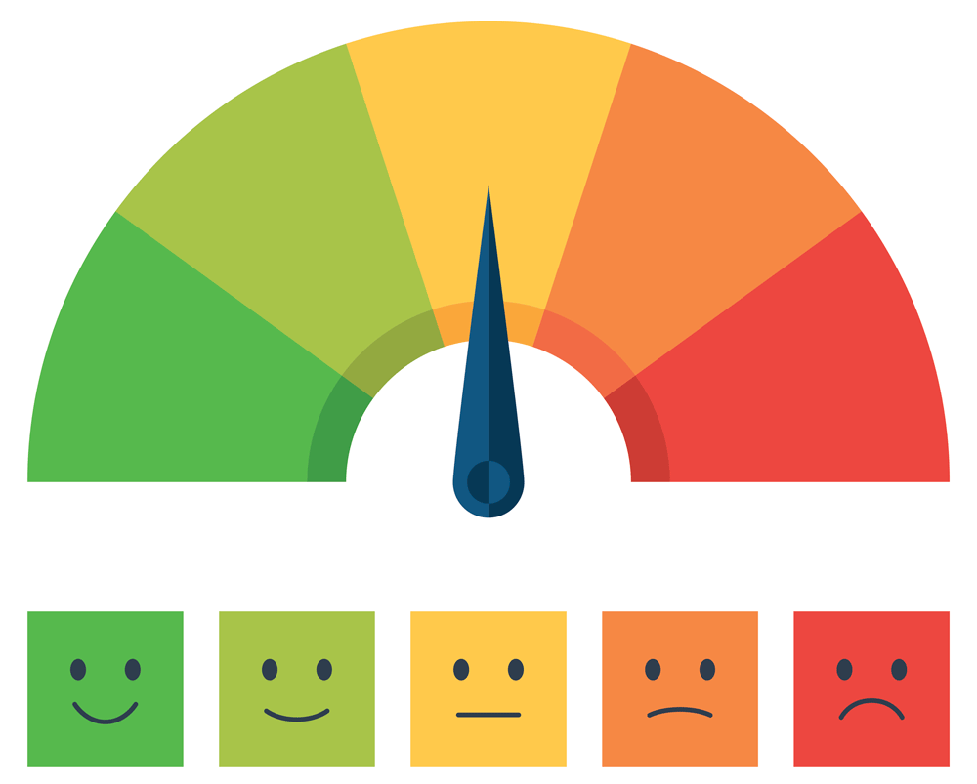

Slide 6
Describe how your idea or project is Infusing AI?
AI/ Machine Learning for face/audio recognition
Amita use AI and data to detect mental illness of user
Amita is using AI to learn about user mood swing
Amita will use AI for having a friendly chat with user
NATURAL
LANGUAGE
PROCESSING
COMPUTER
VISION
ARTIFICIAL INTELLIGENCE
DATA

Slide 7
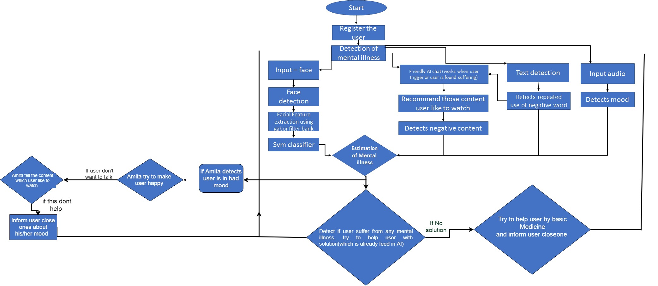
Methodology

Slide 8
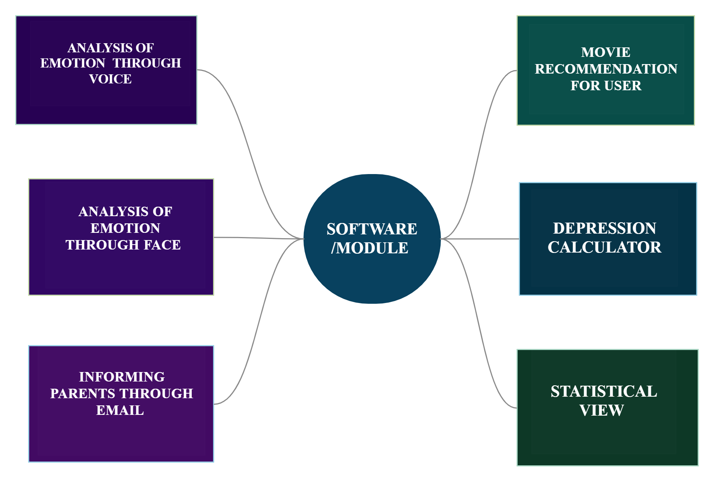

Slide 9
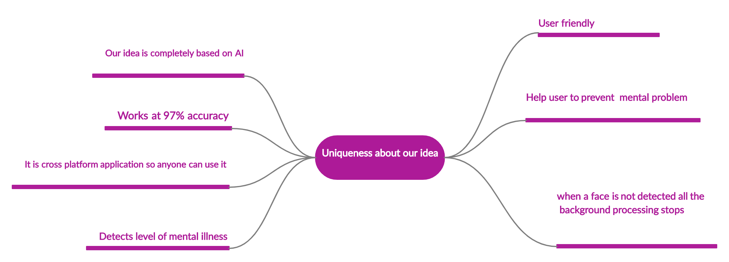

Slide 10
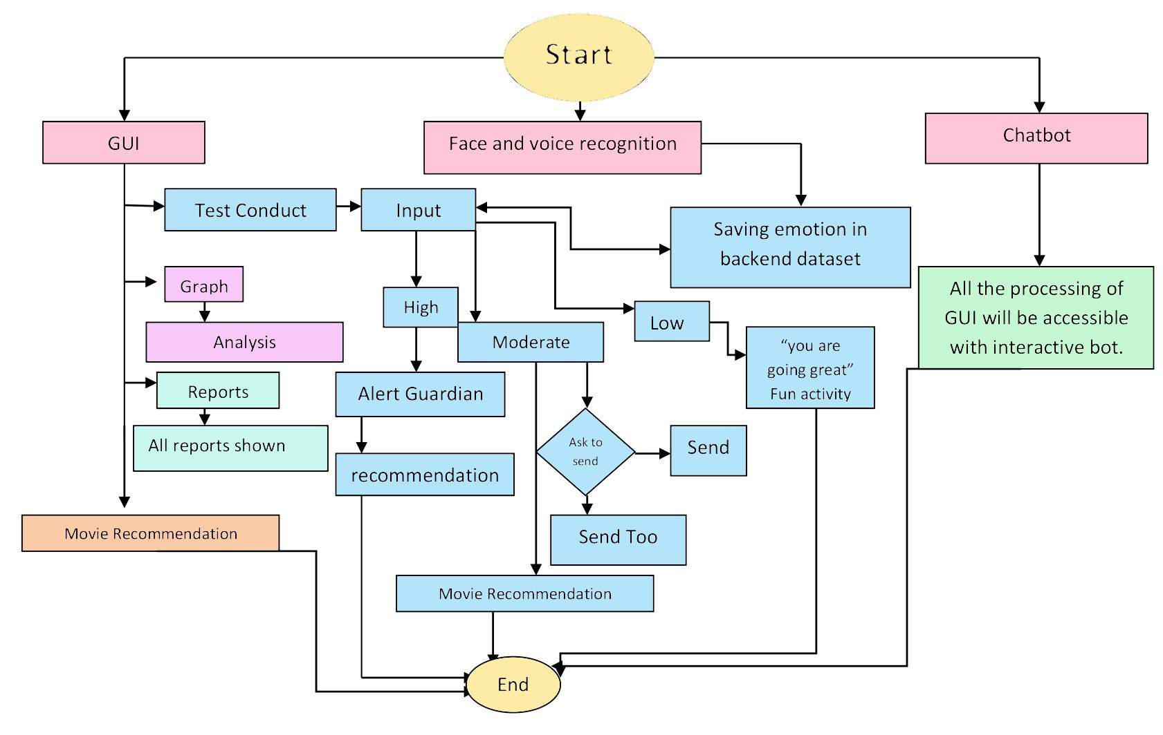
I
N P
U
T
/
O
U
P
U
T

Slide 11
VIDEO

Slide 12
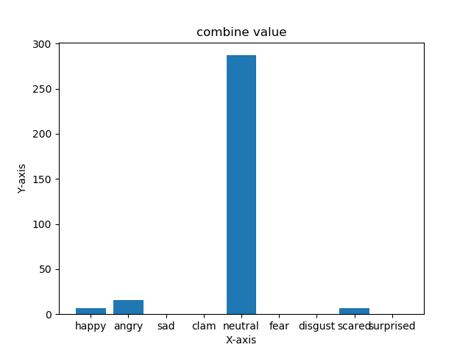
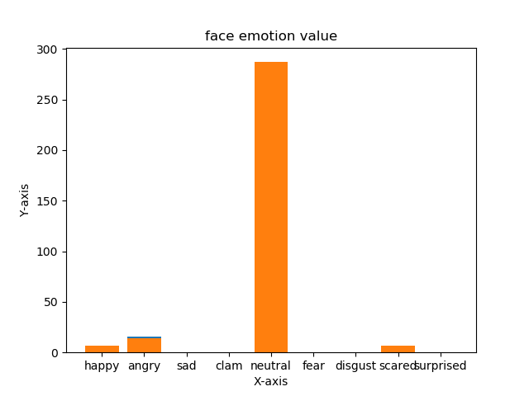
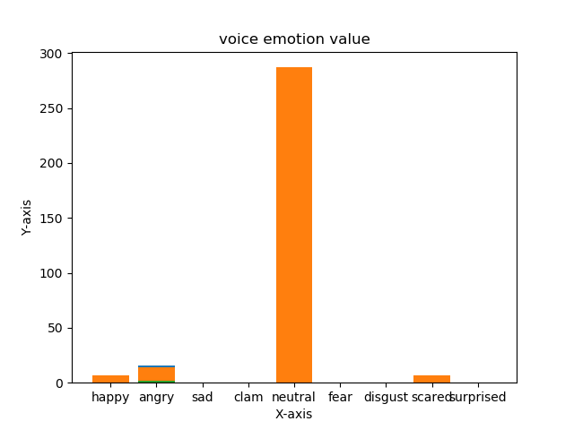
Graphical Representation of Recognition

Slide 13
Future implementation
Making chatbot more advance
Encrypting user email password
Reading data for specific user only
Making android App (we tried using Chaquopy but It don’t have all version of tensorflow)
Making recommendation for more advance for Bollywood ,youtube video, series ,on user interest
User activity tracking
Removing GUI and making chatbot for all funcion
chatbot will be only work when it will be asked to do so
What we have already done
Made Face recognition/audio recognition so advanced that stops when no face detected
Sending mail
Calculating depression of user
Movie recommendation
chatbot

Slide 14
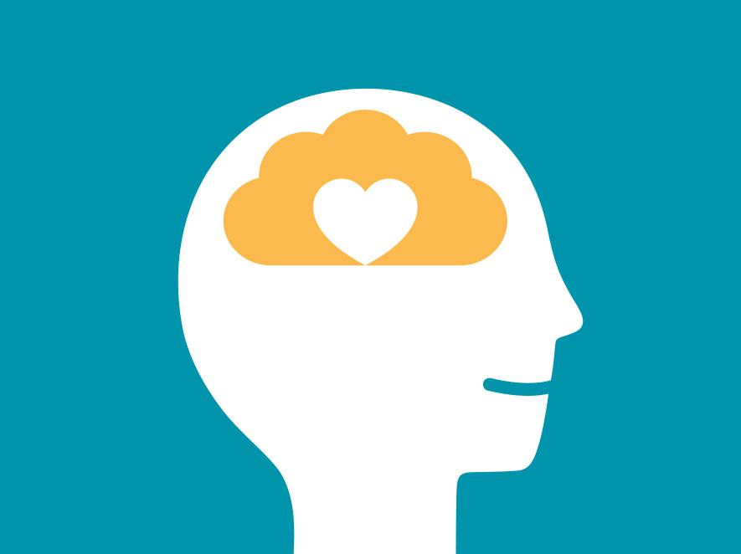
How our solution will help solve the problem and make India better?
WHO estimated that the burden of mental health problems is a tune of 2334 DALYs per 1,00,000 population. Our project deals with the very birth of these mental issues and deal with them at early stages .
Also India's public mental landscape has transformed dramatically over the last couple of months due to prolonged lockdown and our project may help us with these problems.

Slide 15
How effective is the solution that makes India Better?
1) We will be able to tackle the situation as it can help reduce the percent as per INDIAN JOURNAL OF PSYCHIATRY prediction 12% TO 13% of Indian adolescent population is facing some other form of mental illness
2)AMITA is a machine learning based chatbot which does not pass any judgement so that user can easily interact without any second thoughts as it’s there when one talks to human
3) It is also compatible with our SDG GOAL 3:“ GOOD HEALTH AND WELL BEING”.

Slide 16
“ What we will achieve inwardly will change the outer reality”
THANK YOU

Slide 17
Who are your team members?
Anshul – Face recognition/audio recognition , email module , depression calculator ,gui, movie recommendation
Sanskar –chatbot , dataset
Shivli – chat bot, email module, presentation ,documentation, connecting team member
Contact Team Amita
anshul348567@gmail.com

